Slide 1
Content
Docker Installation
Docker CLI Commands
Pull image from docker hub repository and run the image as a container using run command and docker-compose. Pull and run/execute tomcat docker image from docker hub repository.
Create docker Image using docker file. Publishing it into the docker repository
Pulling that image, running that image, executing in interactive mode

Slide 2
Docker
Docker is an open platform for developing, shipping, and running applications.
Docker enables you to separate your applications from your infrastructure so you can deliver software quickly.
With Docker, you can manage your infrastructure in the same ways you manage your applications.
By taking advantage of Docker's methodologies for shipping, testing, and deploying code, you can significantly reduce the delay between writing code and running it in production.

Slide 3
Need of Docker
Before docker has introduced developers and testers experienced difficulty due to the different computer environments. i.e. the code on one system doesn’t work on another system.
The solution was Virtual Machine.
Docker was introduced as an alternate solution.
Docker is an open platform for developing, shipping, and running applications.
Docker provides the ability to package and run an application in a loosely isolated environment called a Container.
Many containers can run simultaneously on a given host.
Container contains everything needed to run the application, so you do not need to rely on what is currently installed on the host.

Slide 4
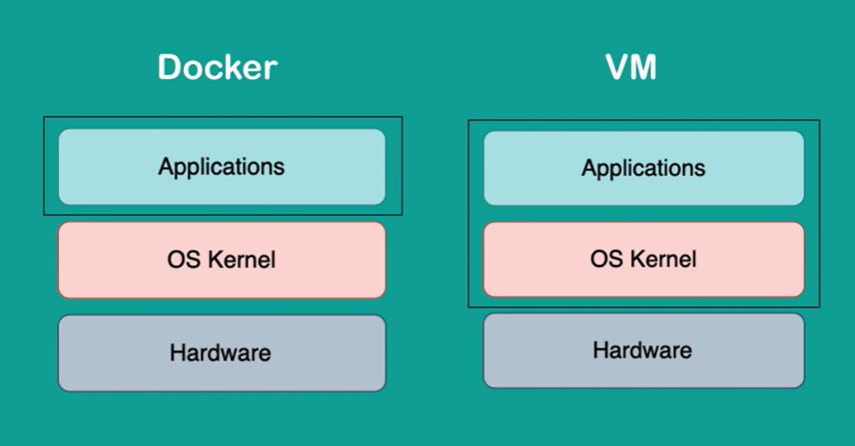
Difference Between Docker and VM

Slide 5
What is Docker
Docker includes Docker client, Docker server, Docker hub, etc.
Docker client is like CLI. It is a tool we issue commands to reach out to the Docker daemon.
Docker daemon is a service that runs on your host operating system.
Docker daemon convert image to the container, run, stop the container
Image is a file containing information (related to required resources)
Container holds all resources to run the image. It occupies a small part of the CPU, RAM, HD.

Slide 6
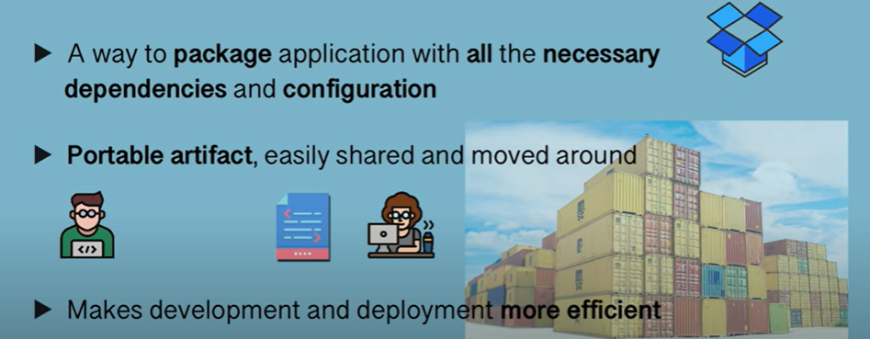
Container

Slide 7
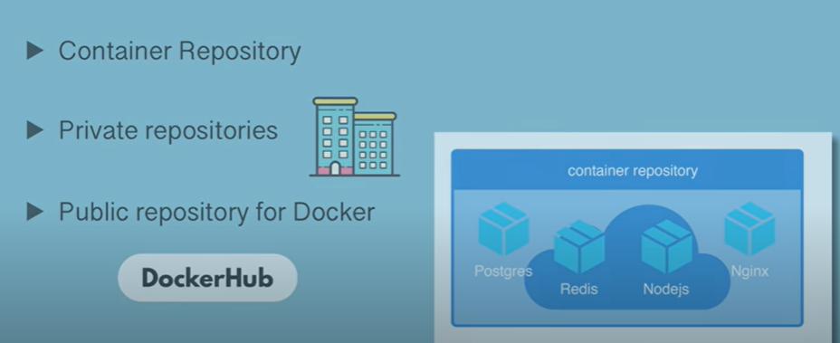
Where do container live

Slide 8
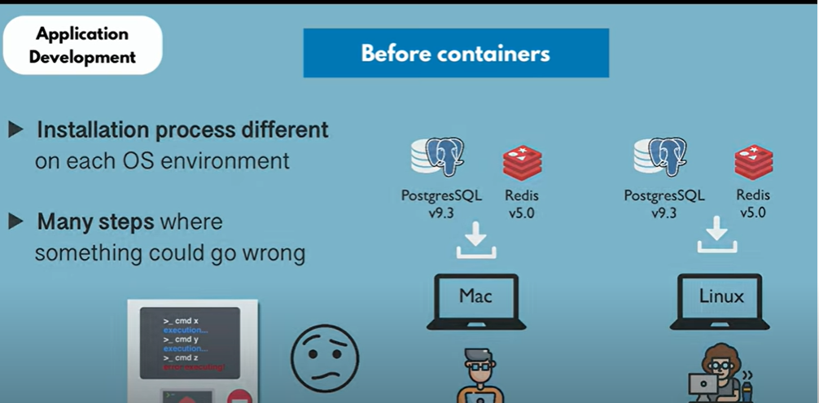
Developer Developer

Slide 9
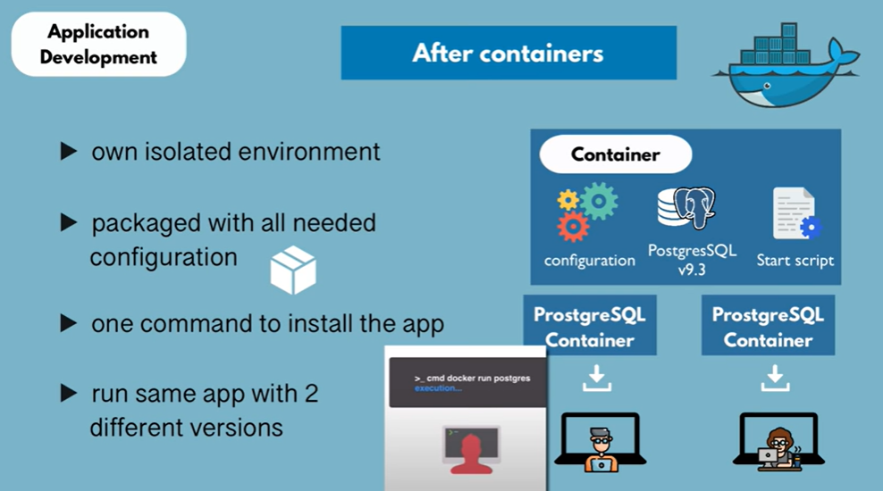

Slide 10
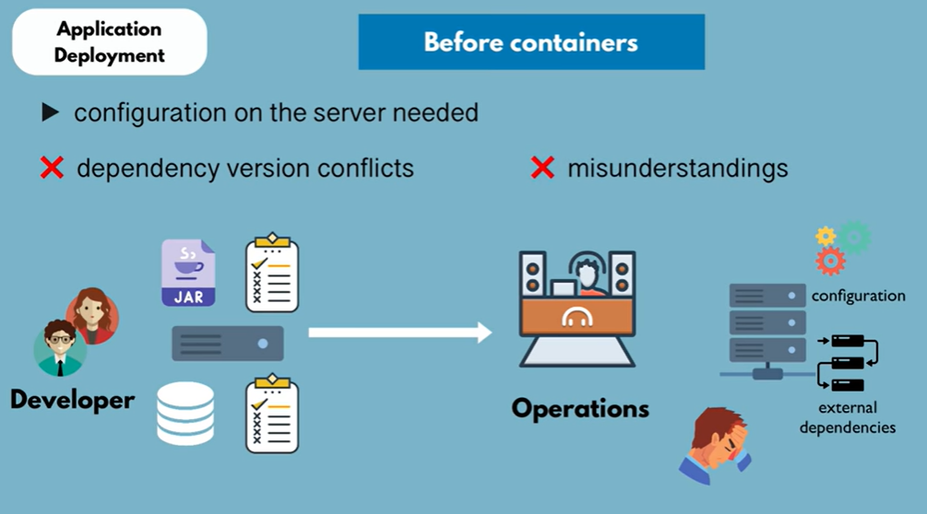

Slide 11
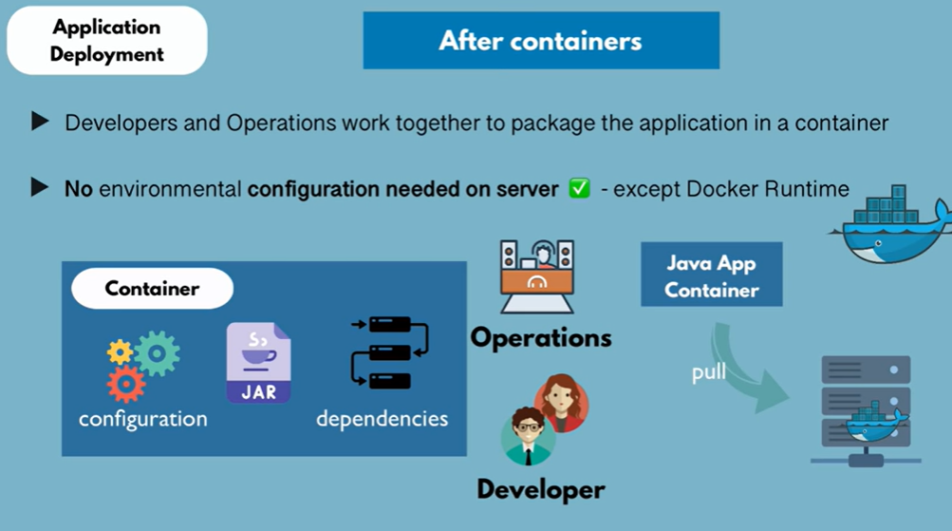

Slide 12
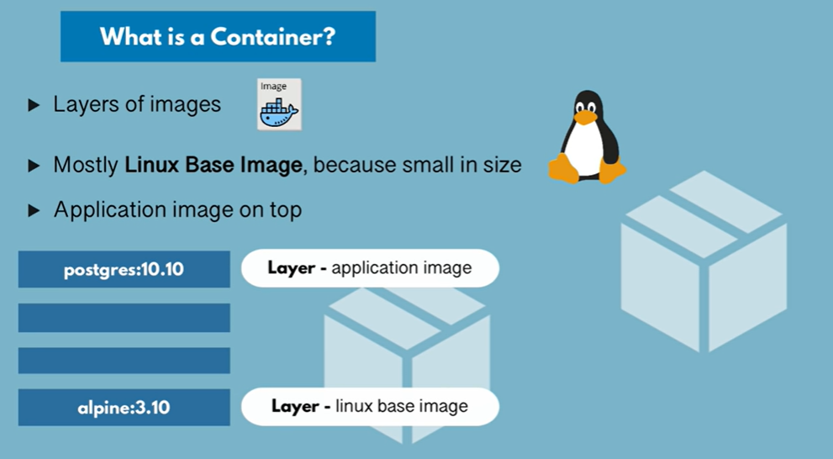

Slide 13
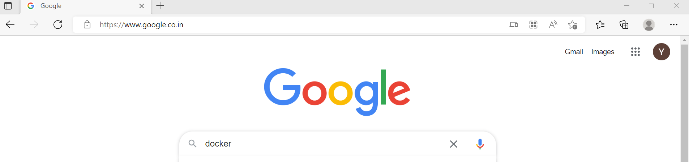
Docker Installation
Go to google and type docker

Slide 14
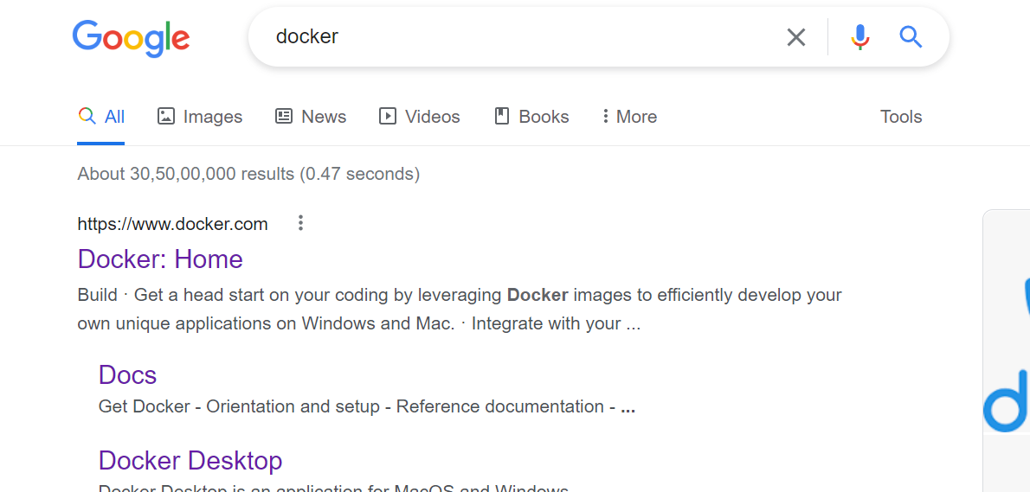
Click on Docker Home

Slide 15
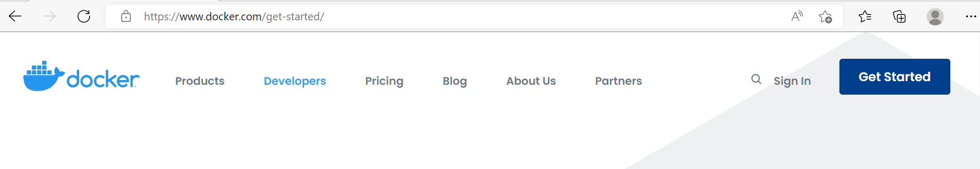
Press on GET STARTED

Slide 16
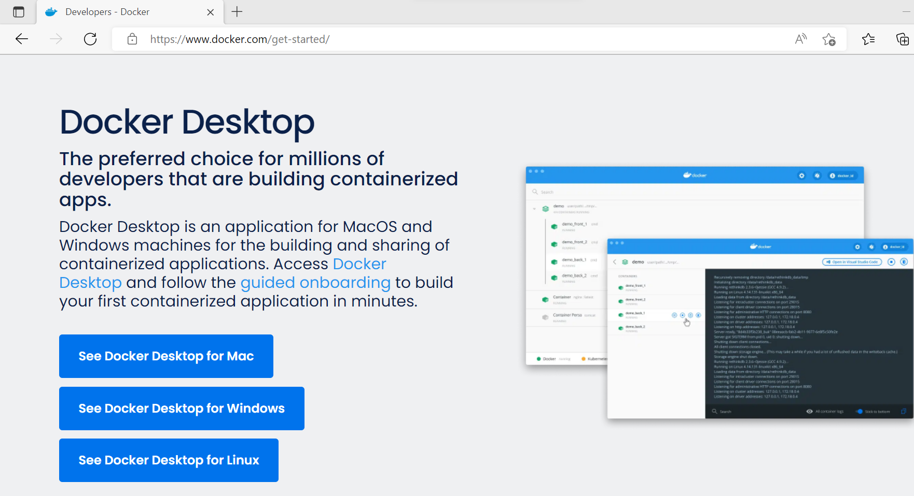
Click on see Docker Desktop for Windows

Slide 17
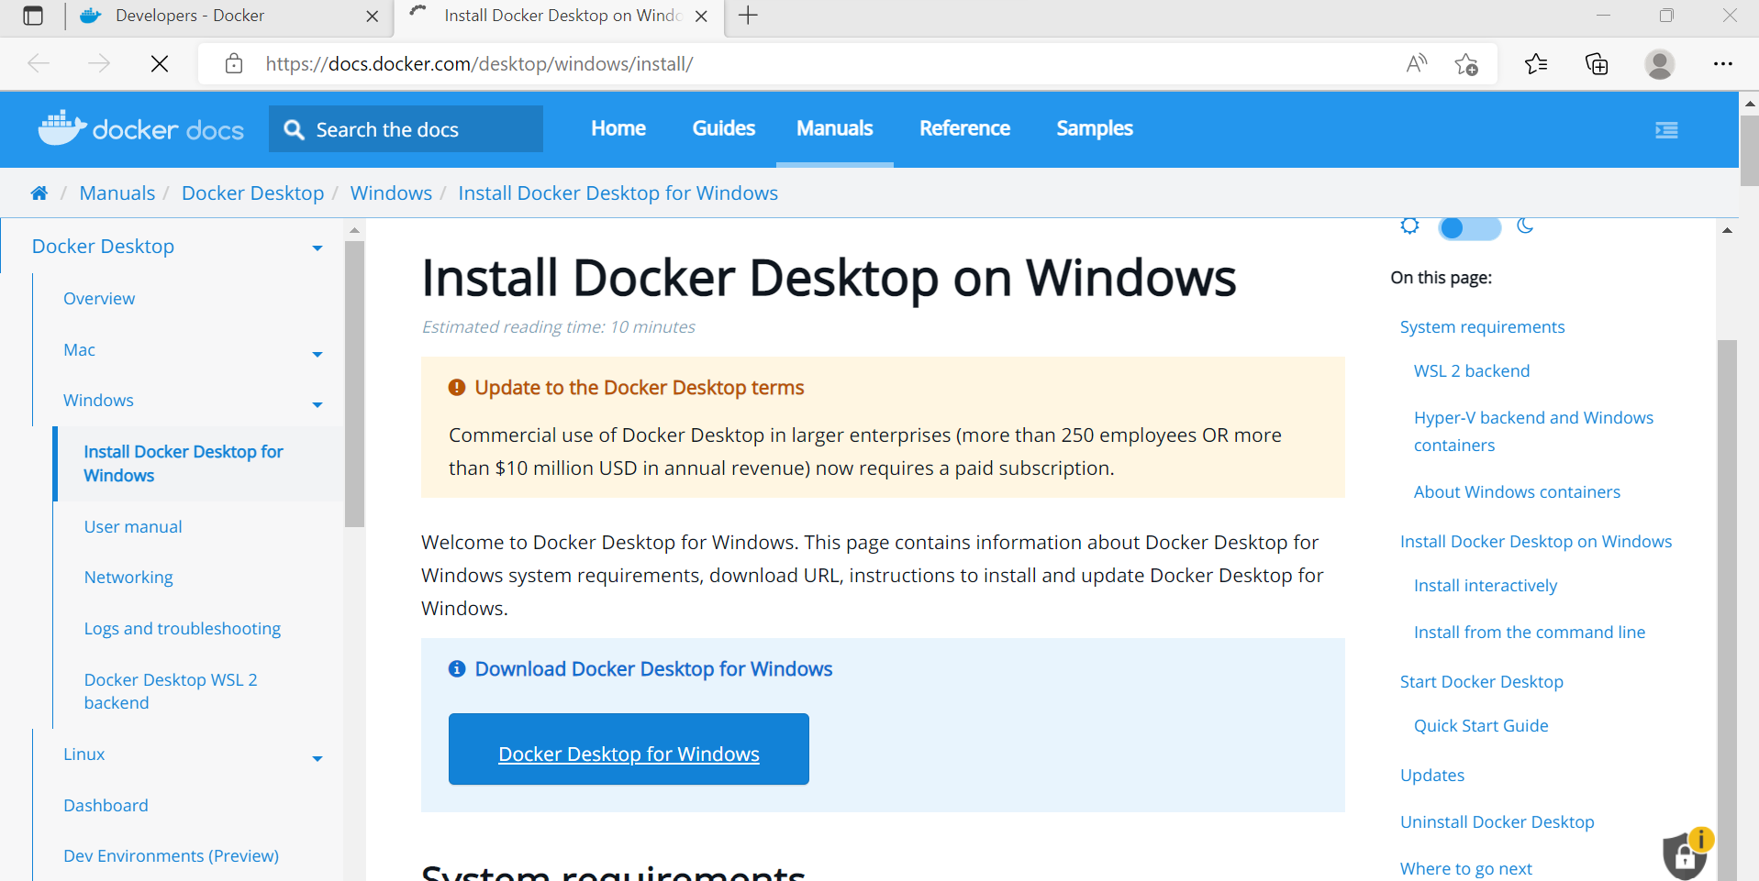
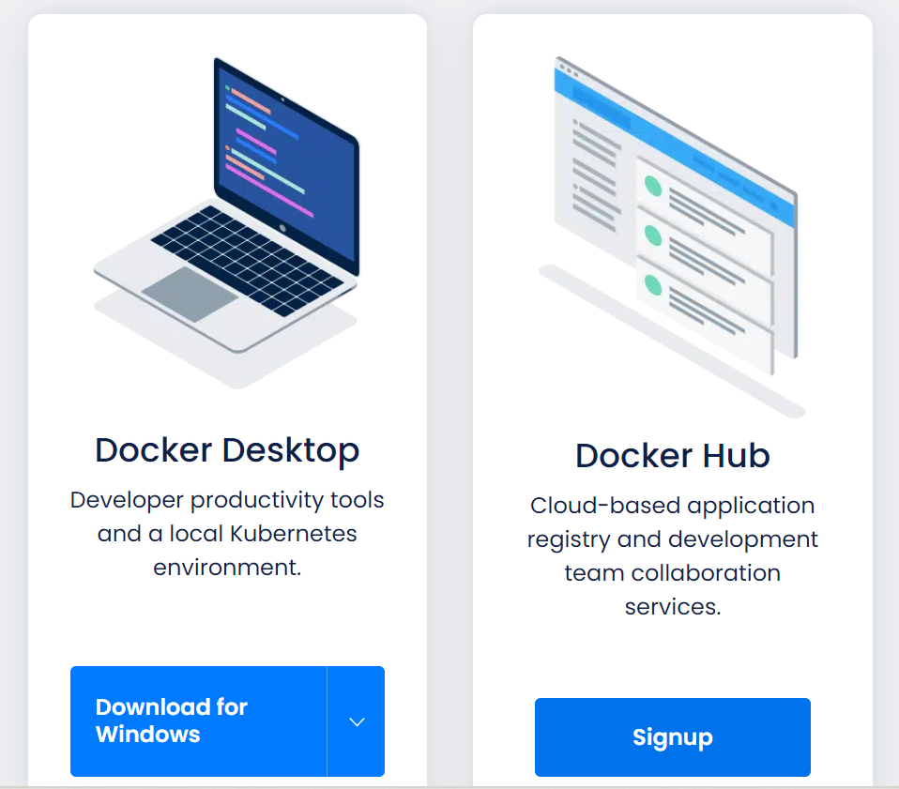
Click on Docker Desktop for Windows to download file

Slide 18
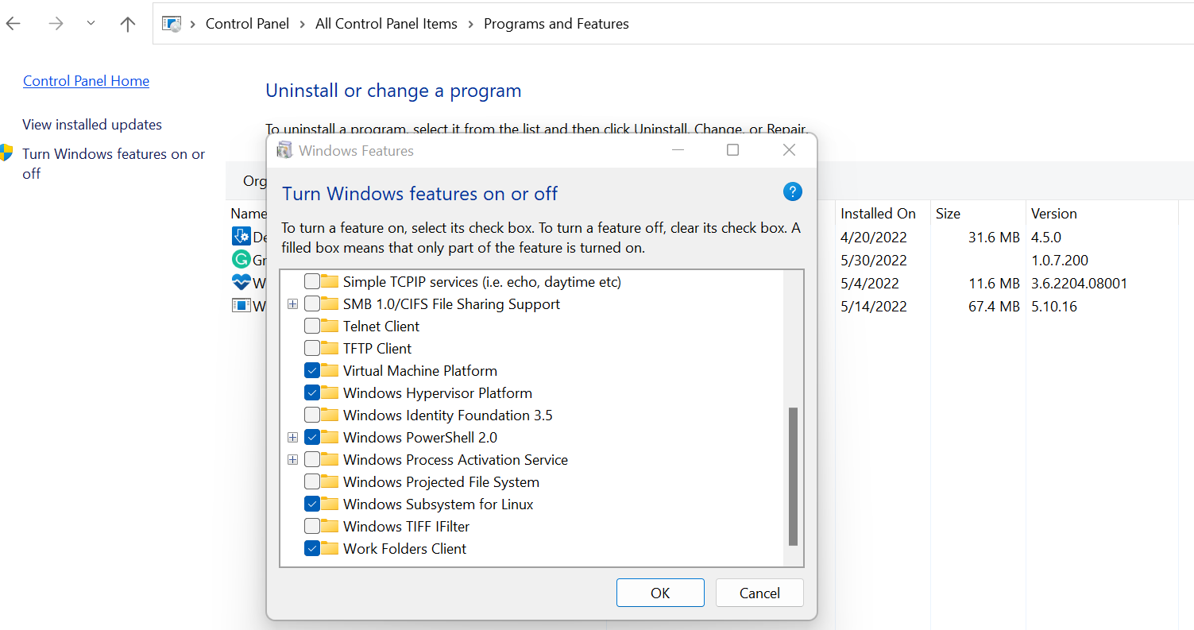

Before installation do the following steps
Goto Control panel->Programs and Features->Turn Windows feature ON and OFF and click on it. Now check all given below are enabled

Slide 19
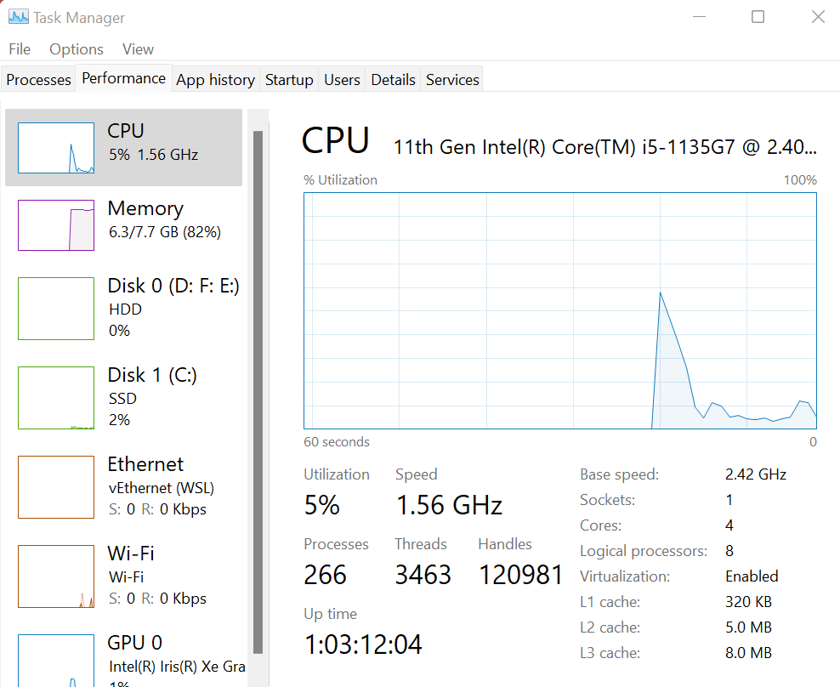

Step 2: Press Ctrl+ALT+delete to goto Task manager, click on Performance and then check Virtualization is Enabled

Slide 20
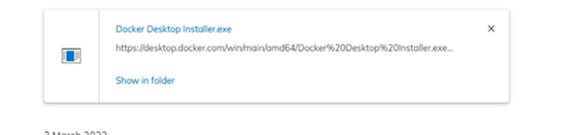
Click on downloaded Docker Desktop Installer.exe

Slide 21
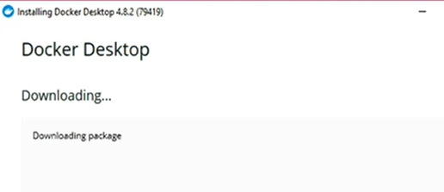
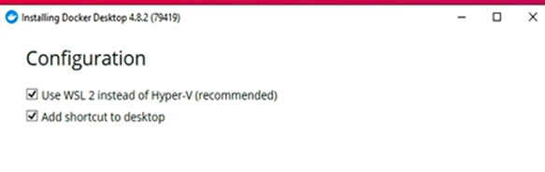
It shows docker packaging
The below window will not appear if WSL2 already enabled

Slide 22
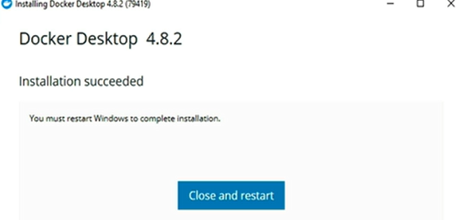

Slide 23
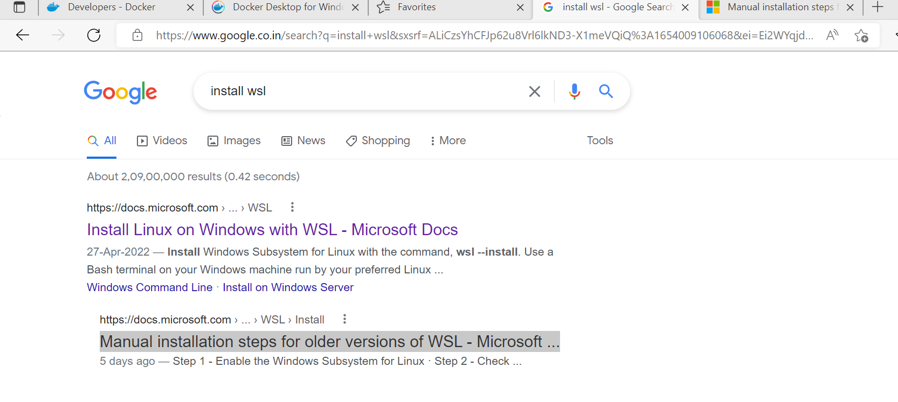
If you want to install , first type (install WSL) then click on Manual installation steps for older versions of WSL - Microsoft ...

Slide 24
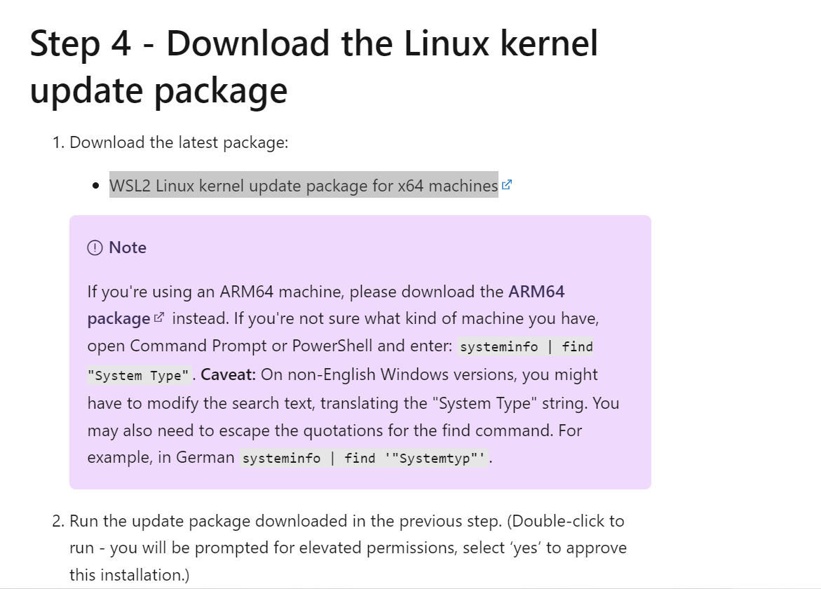
Download WSL2 Linux kernel update package for x64 machines and install

Slide 25
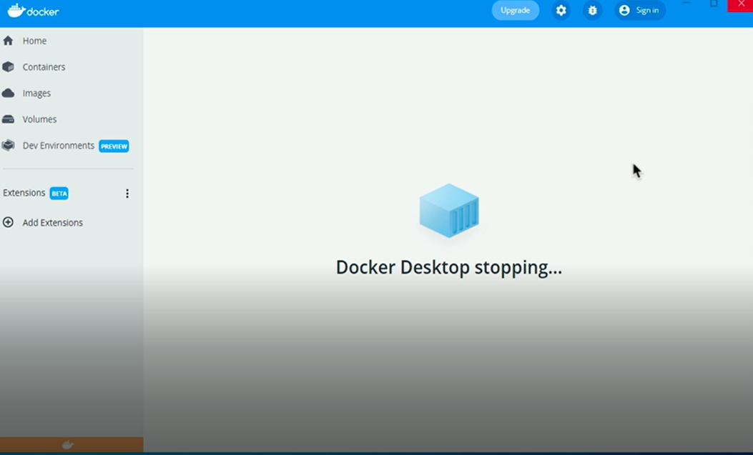
Next Displays

Slide 26
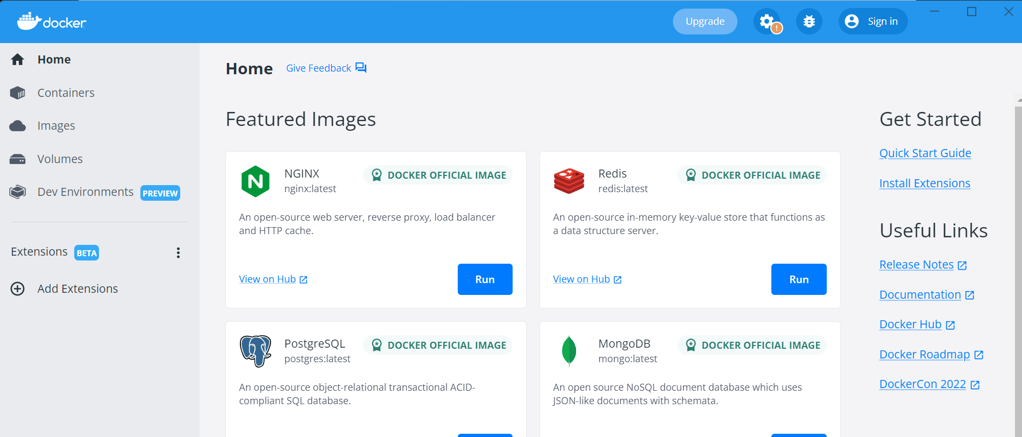
Now Clicking Docker on a desktop must display these images

Slide 27
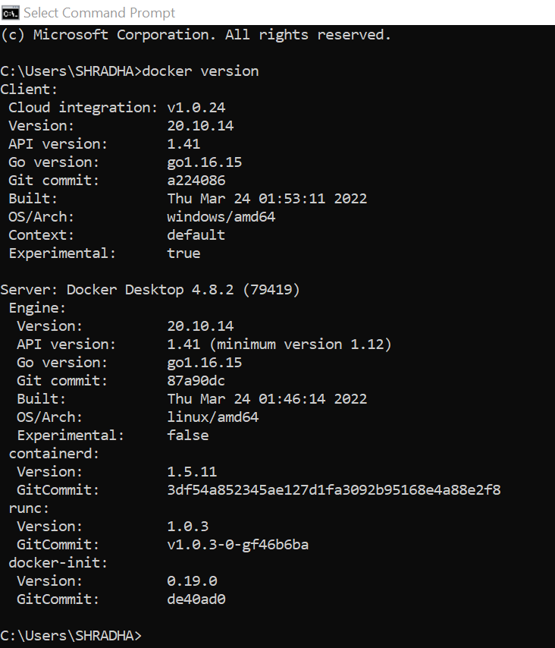
To check docker has been installed correctly type (docker version in command prompt). It should show both client(windows) and server(linux)

Slide 28

Docker CLI
You can distribute your software or application in either Linux, Windows or MAC and can run it on dockers
$ docker --version
displays the version of the docker

Slide 29
$ docker version
It should show both client(windows) and server(linux)

Slide 30
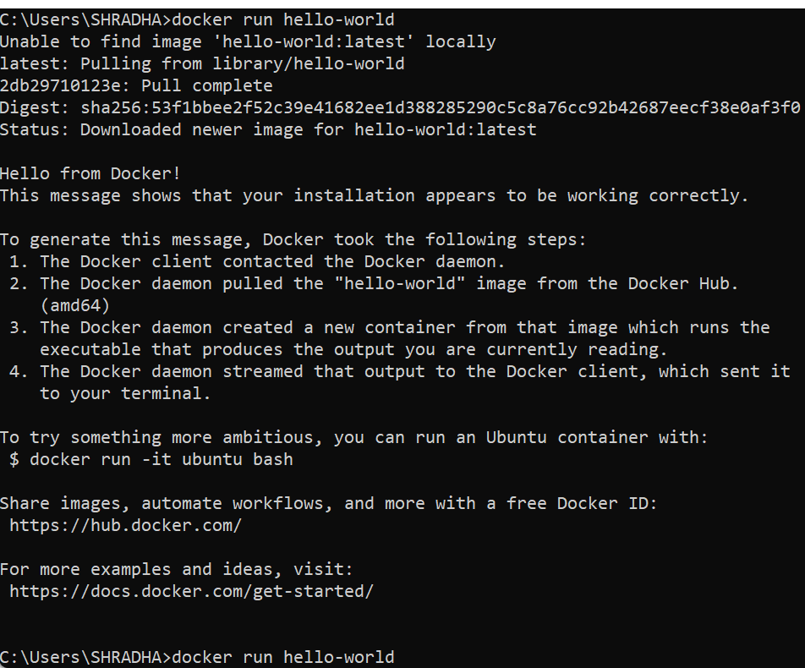
$ docker run hello-world 1. pull docker image hello-world locally 2. First, check in the cache, if not present, get from docker hub. 3. Then create a container for it and run

Slide 31
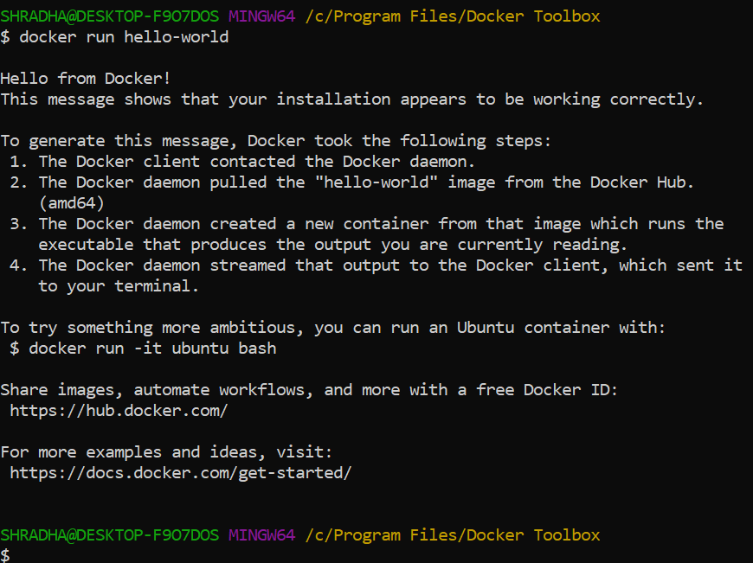
$ docker run hello-world 1. executes a docker image hello-world locally

Slide 32
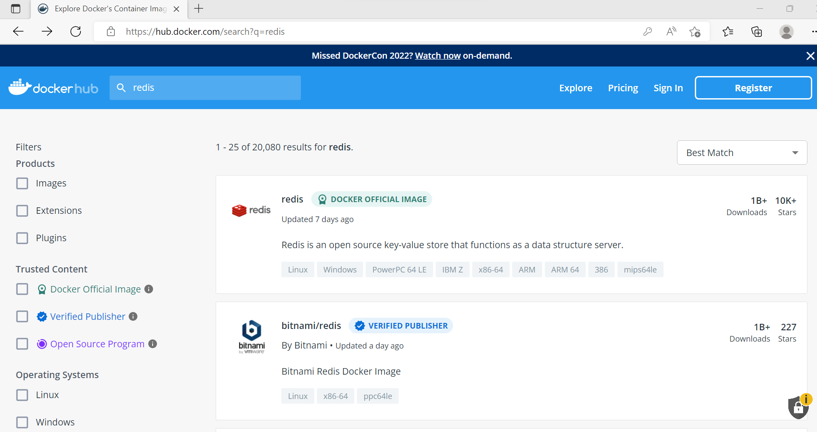
Get images from docker hub
Goto dockerhub.com and you get many images. Now click on redis image

Slide 33
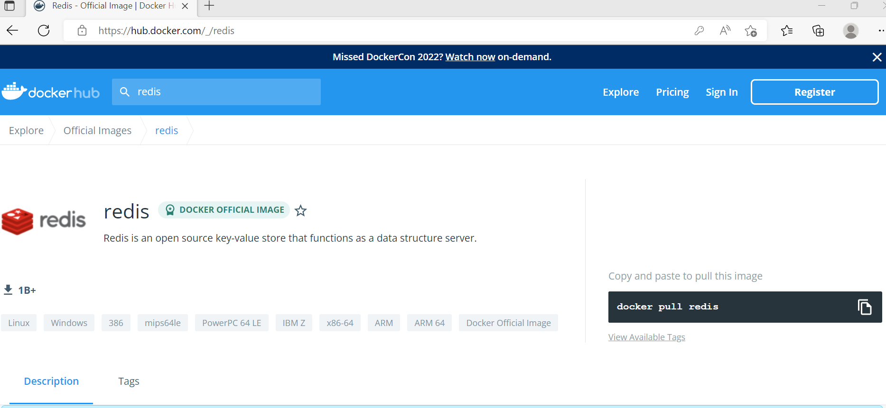
Copy docker pull redis and paste in command prompt

Slide 34
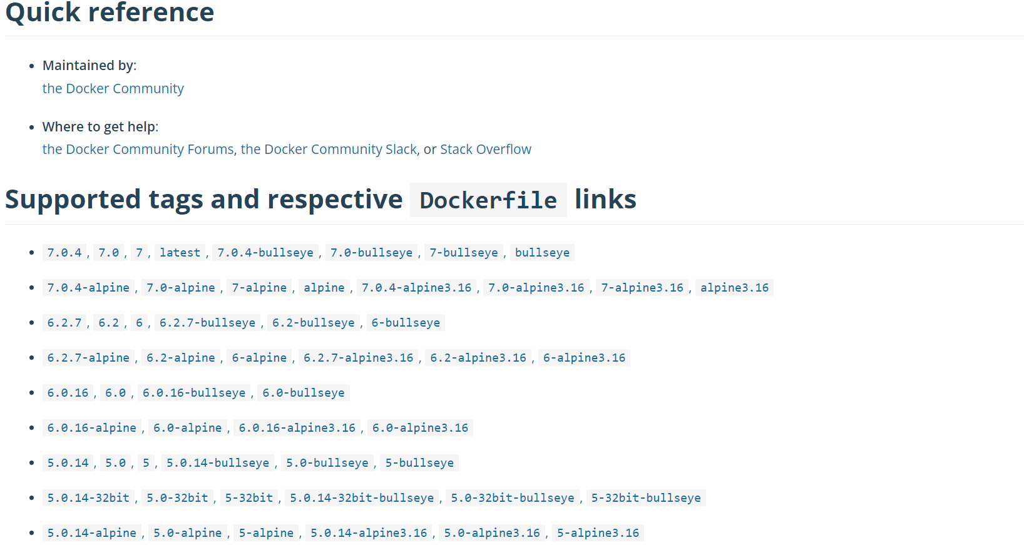
If you go below in docker hub page, you can see redis versions

Slide 35
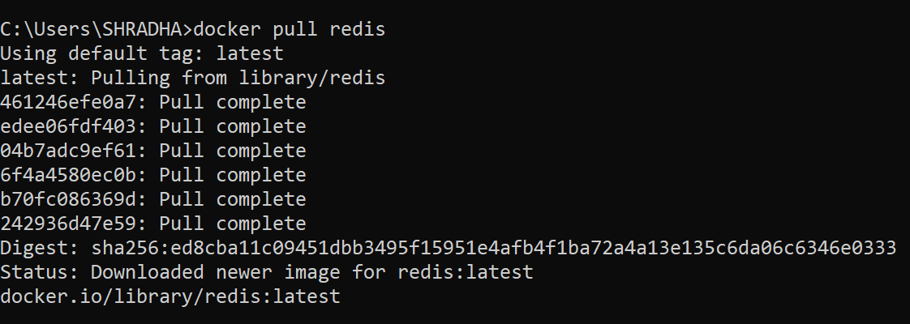
Pull redis image C:\Users\SHRADHA>docker pull redis

Slide 36
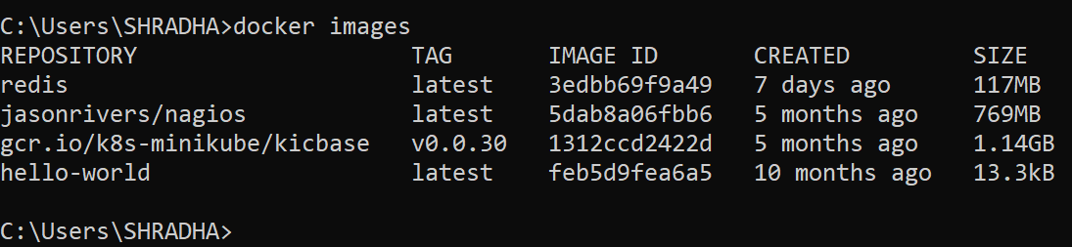
C:\USERS\SHRADHA>docker images Shows two images redis and hell-world image. Tag latest means it has downloaded latest version. It shows size of image

Slide 37
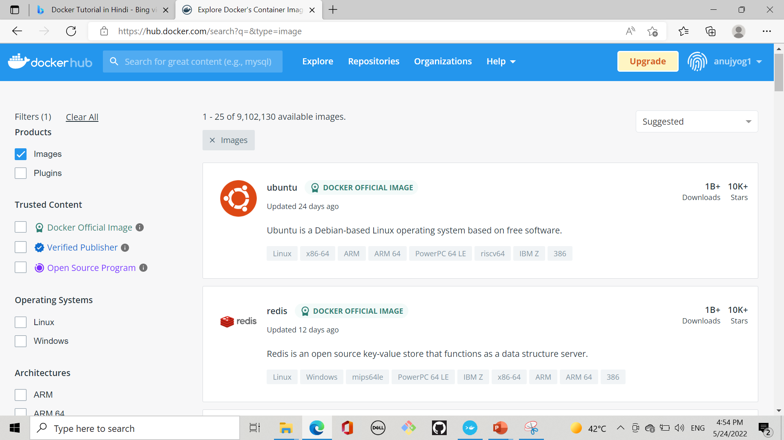
Create docker Hub account Here it has redis image

Slide 38
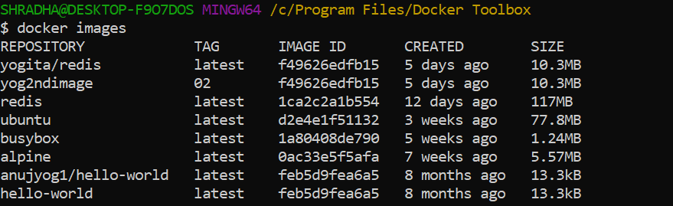
docker images command shows all images $ docker images

Slide 39
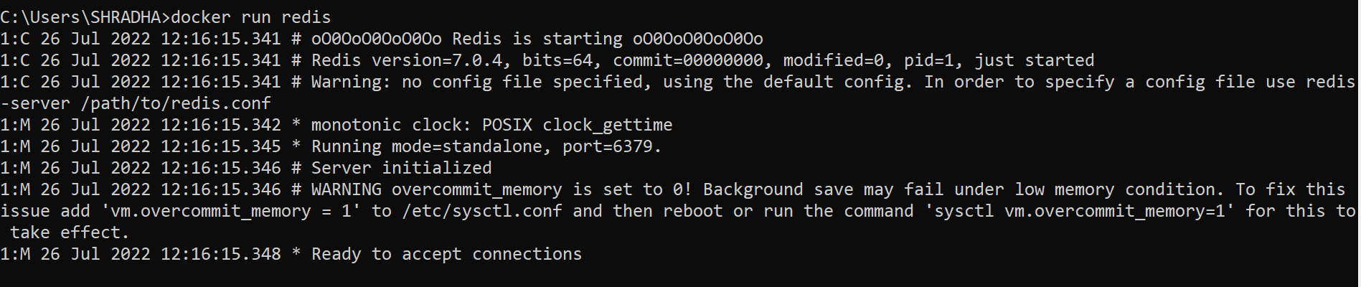
docker run command
C:\Users\SHRADHA>docker run redis It starts image in the container as the container is running environment of image and get connect to Redis application

Slide 40
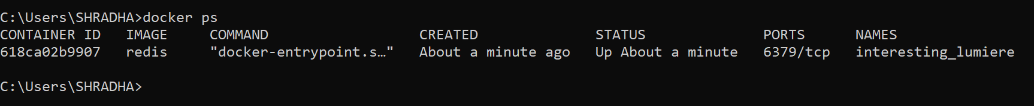
docker ps command
Now open new terminal and type
C:\Users\SHRADHA>docker ps Shows container ID of image and port on which it is running

Slide 41
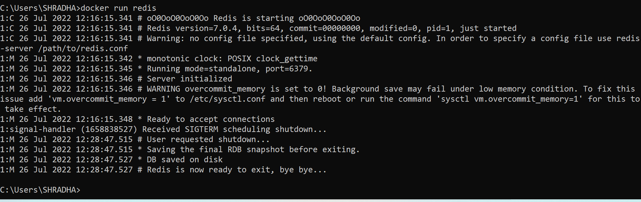
Goto previous command prompt and press Control C to stop redis container running

Slide 42
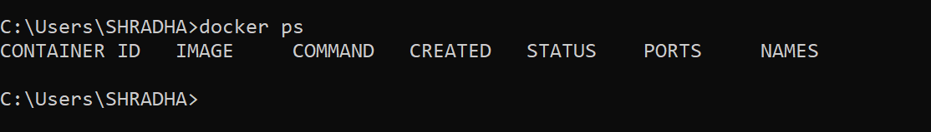
If u give in other command prompt C:\Users\SHRADHA>docker ps it shows container stopped running

Slide 43
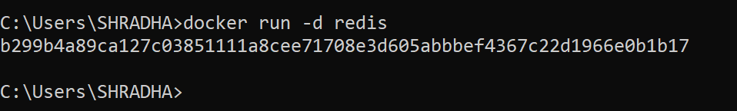
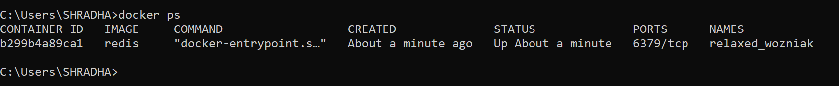
Run in detached mode means starts new container with command

Slide 44
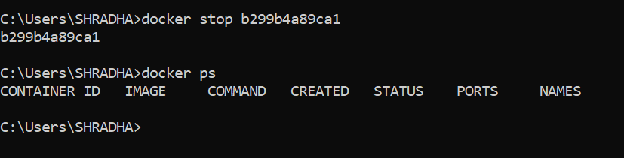
stop command stops running container
$docker stop command

Slide 45
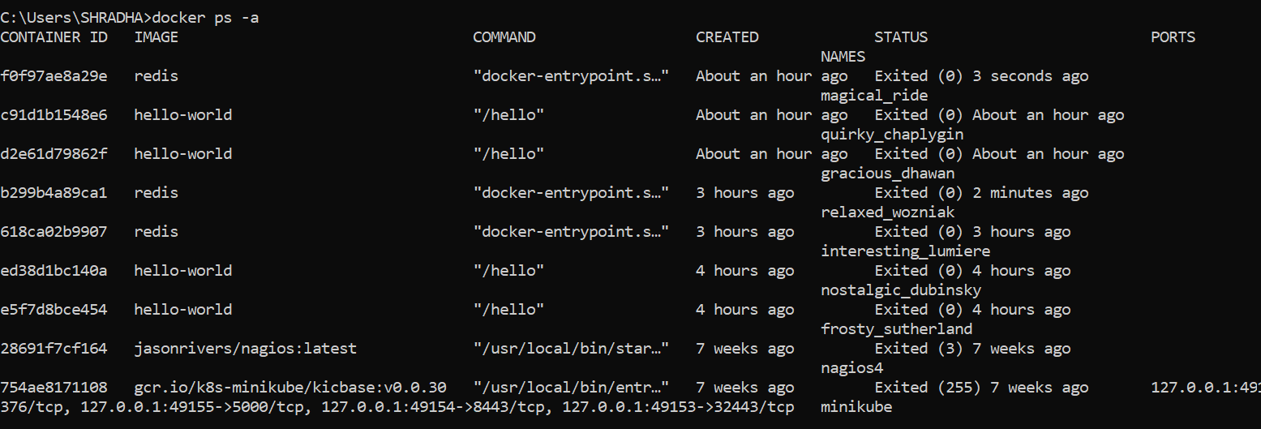
$docker ps –a shows both running and stopped containers

Slide 46
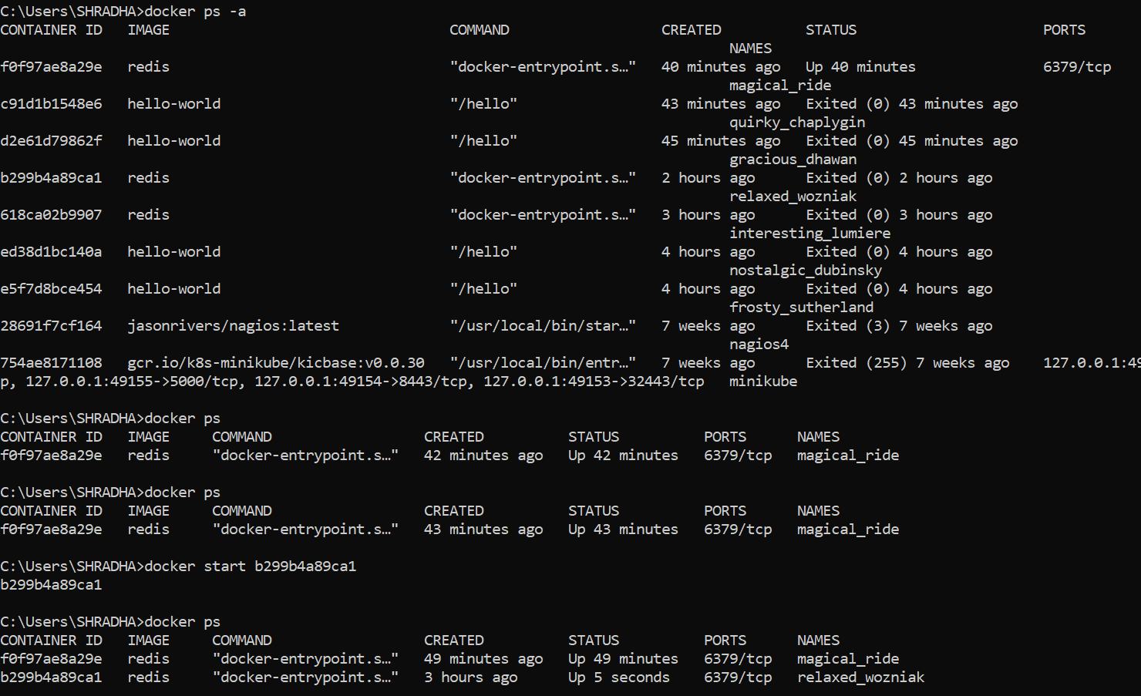
$docker start containerID used to restart the container if it has stopped due to application crash or if error occurred

Slide 47
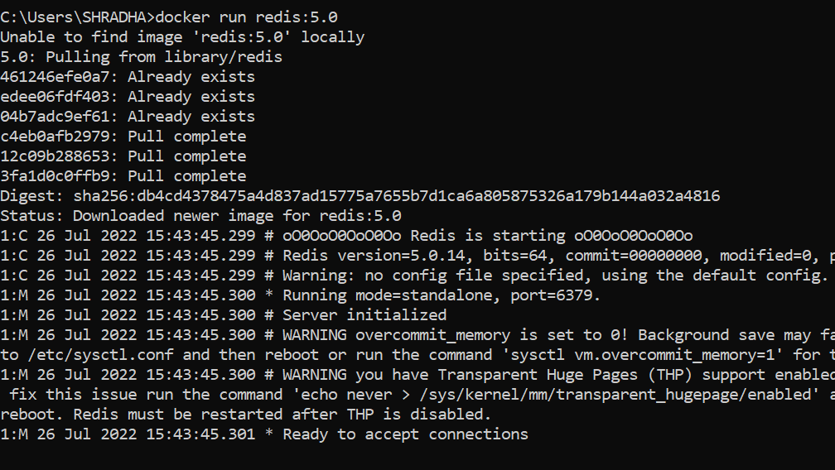
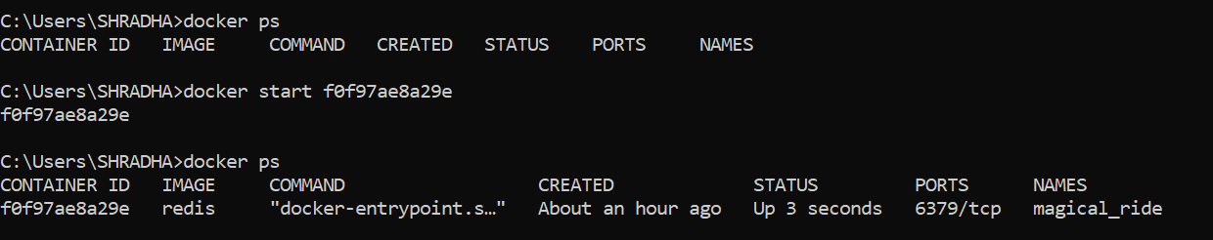
Creating same image with different version in one application docker run redis:5.0

Slide 48
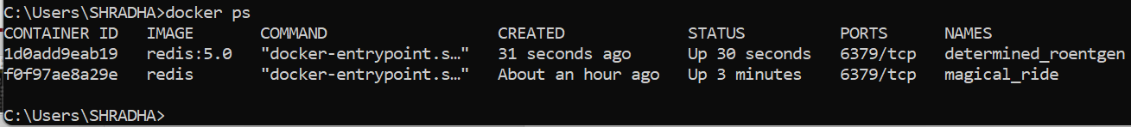
Here are two redis images with different versions run using a container having the same port 6379 number. The containers having the same port can be bind to a different port on a host machine/ laptop.

Slide 49
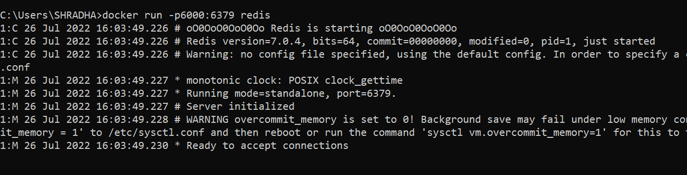
Use –p port number to bind the redis to port 6000
new port number
old port number

Slide 50
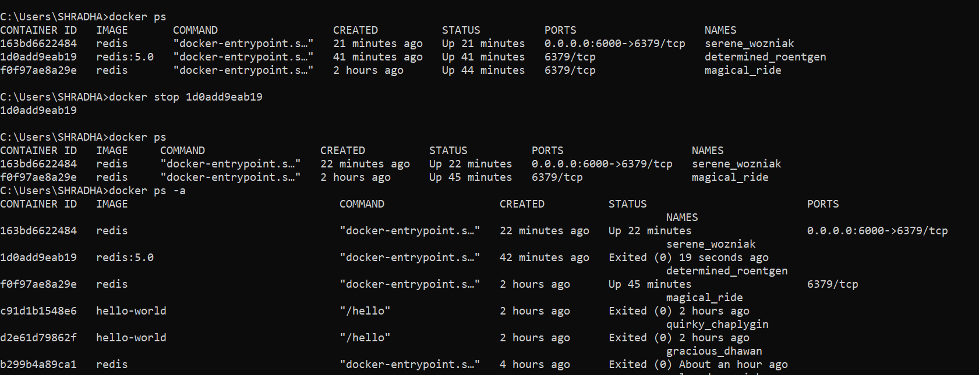


Shows redis binded to port 6000

Slide 51
If redis:5.0 connected to same port 6000, then shows port error

Slide 52
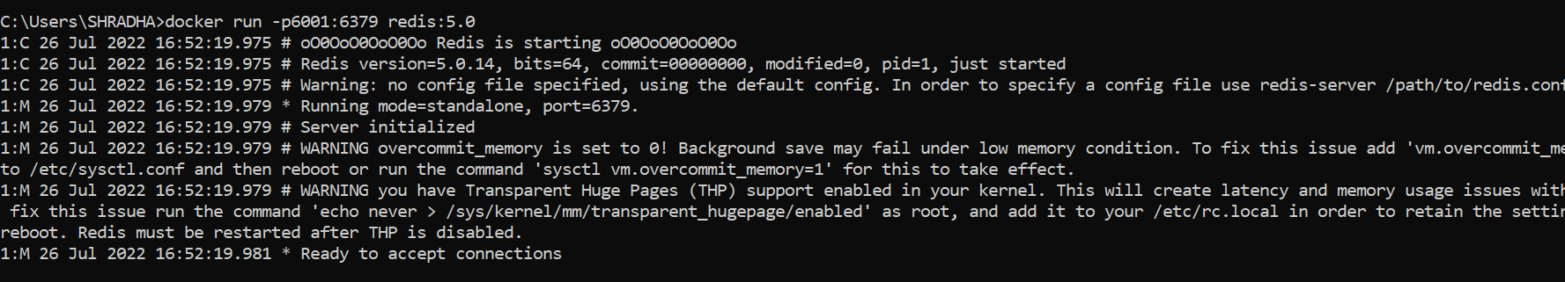
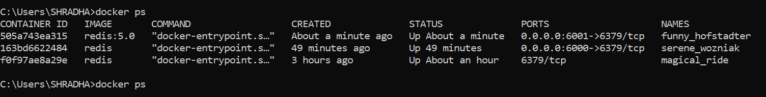
Now redis:5.0 connected to port 6001

Slide 53

Troubleshooting containers using logs $docker logs 505a74ea315 Helps to see what’s going on in container

Slide 54

Naming the container redis 5.0 named as older docker run –d –p6001:6379 --name redis-older redis:5.0

Slide 55

redis named as newer docker run –d –p6000:6379 –name redis-newerr redis

Slide 56

$ docker ps –a Shows all running and stopped containers

Slide 57

$ docker logs 5e14e17ec435 shows commands running in container with id 5e14e17ec435

Slide 58

$ docker stop f5222408e8b3 used to stop running container here f5222408e8b3 is container id

Slide 59
Running container in interactive mode
$docker exec -it f0f97ae8a29e /bin/bash
Runs a container in interactive mode.
Helps to see all directories, go to the home directory, see the virtual file system inside the container, navigate to different directories, and can see environment variables Here,
-i mean connect stdin to this container.
-t means give formatted output.
bash is a command processor, it starts terminal in this container. Press ^C to exit from this container or give exit to exit from interactive mode

Slide 60

$docker login login to docker hub with required credentials

Slide 61


Slide 62

$ docker kill f0f97ae8a29e Kills container that is running and does not stop
Publishing it(point 4) into the docker repository
Publishing it(point 4) into the docker repository

Slide 63

$docker exec –i –t 51ae5a4db49b sh Runs a container in interactive mode. Helps to see all directories, goto home directory, see virtual file system inside container, navigate to different directories, and can see environment variables Here -i mean connect stdin to this container. -t means give formatted output. sh is a command processor, it starts terminal in this container. Press ^C to exit from this container

Slide 64


Run ubuntu with echo

Slide 65
Exercise c. Pull image from docker repository and run it as a container
Docker repository contains images like ubuntu machine, node, etc. If anyone wants ubuntu they need not have to download it. We can pull the ubuntu image from the docker repository and run it as a container that will provide all the features of ubuntu.
We bring it in our local repository and run

Slide 66

$ docker search ubuntu displays public images in ubuntu

Slide 67

$ docker pull ubuntu-upstart it pulls this feature from docker repository on our virtual machine. Later we can run it locally

Slide 68

$ docker images shows pulled image ubuntu-upstart

Slide 69

$ docker run -it b28219773b9b /bin/bash runs (-it means) in pseudo tty terminal, the container for image with id b28219773b9b of ubuntu-upstart Here, now we are able to run commands inside the container. So the prompt appears as #

Slide 70

Now run inside container, command #apt-get update Press ^c to stop and exit to exit

Slide 71

Ubuntu image we pulled from docker hub

Slide 72

Similarly we can pull node locally from docker hub. Go to next slide

Slide 73

$ docker search node

Slide 74

Here we directly run the node in our local machine. And run the ls command and exited using the exit command

Slide 75

Exercise 4. Create Docker Image using Dockerfile

Slide 76

Dockerfile
It is plain text file that contains instruction to build image.
In docker hub existing images are present.
Dockerfile helps to create our now image

Slide 77

Steps to follow

Slide 78

Step 1 create Dockerfile
Go desktop, right-click and create a folder named Docker-custom
Open the folder in Visual studio code
Create a file named Dockerfile

Slide 79
Step 2: Add instructions to Dockerfile
In file Dockerfile, type commands as below
# step specify the base image
FROM alpine
#download and install dependencies
RUN apk add --update redis
#setup startup command
CMD [ "redis-server" ]
b. Control+S to save

Slide 80

Code in Docker file

Slide 81

Step 3: Build Dockerfile to create image
Open terminal in Visual Studio Code and type
docker build -t yog2ndimage:02 .
-t helps to tag name yog2ndimage:02
yog2ndimage means give as username
02 means give as version of your image

Slide 82





Slide 83

Continued… if prompt not appear close and open again

Slide 84

Continued…

Slide 85



$docker images Here image with yog2ndimage created

Slide 86


Step 4: Run the image with image ID f49626edfb15 to create a container $docker run f49626edfb15

Slide 87

Exercise 5. Publishing docker image into docker repository
First create docker hub account at dockerhub.com
Go to Windows powershell
Login to docker at shell by $ docker login command. It will ask user name and password

Slide 88

We will tag image yog2image with tag 02 as $ docker tag yog2ndimage:02 anujyog1/secondimage image name version/tag docker id tagname latest

Slide 89


$ docker images shows tagged image anujyog1/secondimage

Slide 90

$ docker push anujyog1/secondimage Pushes image into docker repo with id anujyog1

Slide 91

Goto docker hub account/repository. Now here no image with name anujyog1/secondimage. To get it press on refresh

Slide 92

After refreshing, press on anujyog1/secondimage and see next slide

Slide 93

Here shows image pushed

Slide 94

Here one can press on tag, or share this image using command pull

Slide 95


Exercise 6. Pulling pushed image, running that image, executing in interactive mode
Goto docker hub and copy pull command

Slide 96


Open another terminal in Visual Studio Code Paste Pull command (PS C:\Users\SHRADHA\OneDrive\Desktop\tomcatfile> docker pull anujyog1/secondimage:latest)

Slide 97


Run pulled image
PS C:\Users\SHRADHA\OneDrive\Desktop\tomcatfile> docker run -it anujyog1/secondimage:latest

Slide 98


Continued… Shows ready to accept connections i.e. image Redis is running

Slide 99


